Slide 1
Introduction to Object Oriented Programming

Slide 2
Getting Started

Slide 3
Key Topics
Classes and Objects
Methods
Objects in Software
Compiling and Running a Program

Slide 4
Real World Application
In the real world you see and use various objects, each being of some “kind”, like toy, food, animal, electronics etc.

Slide 5
Real World Application
In Java instead of saying a kind of object, we say a class of objects. A class is like a blueprint of an object. Any program that you’ll write will be made up of classes.

Slide 6
Classes and Objects

Slide 7
Object-oriented programming
OOP attempts to make programs more closely model the way people think about and deal with the world, consisting of a collection of interacting objects.

Slide 8
Object-oriented programming
To write such a program you need to describe different types of objects:
what they know
how they are created
how they interact with other objects.
Each object in a program represents an item that has a job to do.

Slide 9
Object-oriented programming
The world in which we live is filled with objects.
For example, an object we are all familiar with is a drawing tool such as a pencil or pen. A drawing tool is an object, which can be described in terms of its attributes and behaviors.
Attributes are aspects of an object that describe it, while behaviors are things that the object can do.

Slide 10
Attributes
Pencil Attributes are:
its drawing color
width of the line it draws
its location on the drawing surface
etc
Anything that describes an object is called an attribute.

Slide 11
Behaviors
Pencil behaviors consist of:
drawing a circle
drawing a line in a forward or backward direction
changing its drawing direction
etc

Slide 12
Classes
In order to use an object within a program, we need to provide a definition for the object, a class.
The class describes:
how the object behaves
what kind of information it contains
how to create objects of that type.
A class can be thought of as a mold, template, or blueprint that the computer uses to create objects.

Slide 13
Classes
When building a house, a construction crew uses a blueprint to define the aspects of the house.
The blueprint gives the specifications on how many bedrooms there are, how to position the electrical wiring, the size of the garage, etc.
However, even two houses built from the same blueprint may have different paint colors and will have different physical locations.

Slide 14
Classes
Clients who are buying a house may make slight modifications to these blueprints.
For example, they may want a bigger garage or a smaller porch.
We can see the houses built from the blueprint as objects since they are all similar in structure, but each house has its own unique attributes.

Slide 15
Classes
In the world of programming, we can view the blueprint just like a class, i.e. a tool for creating our objects.

Slide 16
Methods

Slide 17
Methods
While a program is running, we create objects from class definitions to accomplish tasks.
A task can range from drawing in a paint program, to adding numbers, to depositing money in a bank account.

Slide 18
Methods
To instruct an object to perform a task, we send a message to it.
In Java, we refer to these messages as methods.

Slide 19
Methods
An object can only receive a message that it understands, which means that the message must be defined within its class.
Just like when Miss Phillips was a robot, she only knew instructions that were previously defined.

Slide 20
Setting up IntelliJ

Slide 21
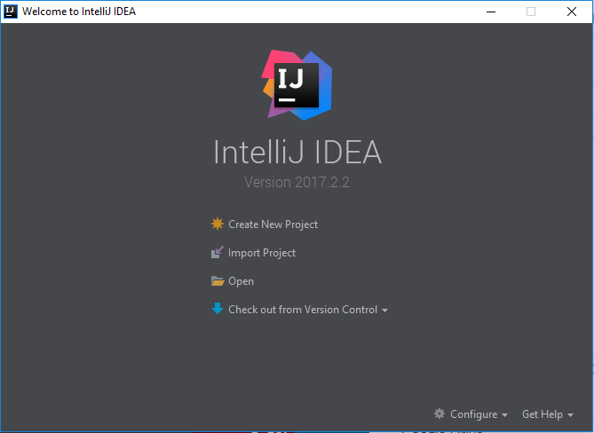
IntelliJ

Slide 22
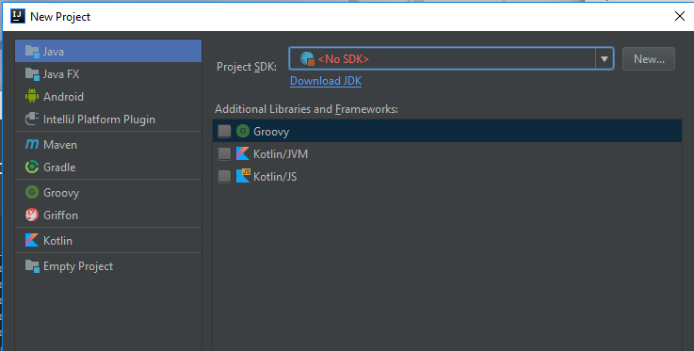
Creating a New Project – Set Up JDK

Slide 23
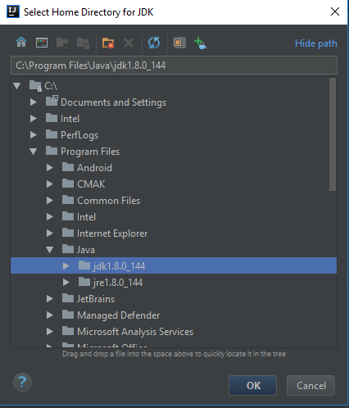
Creating a New Project – Set Up JDK

Slide 24
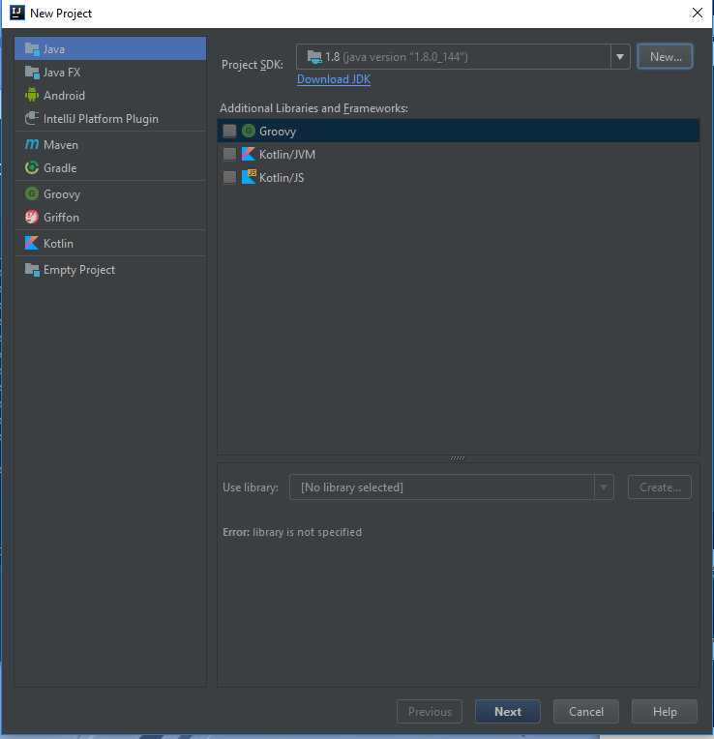
Creating a New Project – Set Up JDK

Slide 25
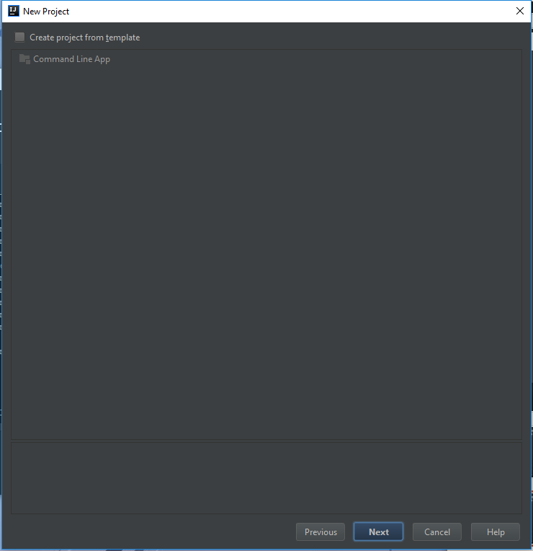
Creating a New Project – Set Up JDK

Slide 26
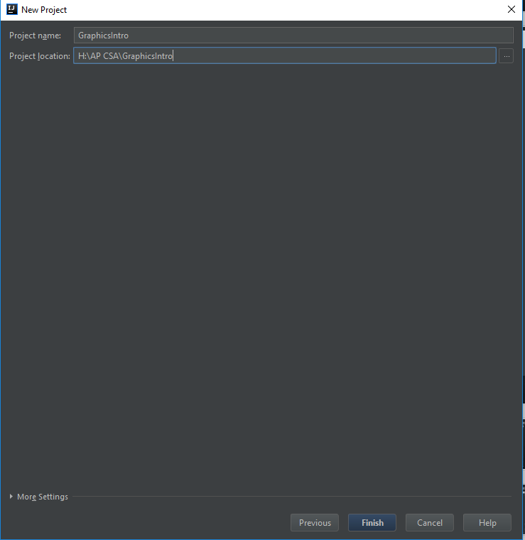
Creating a New Project – Naming the Project

Slide 27
Setting up gpdraw

Slide 28
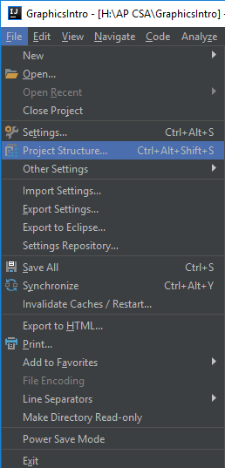
GPdraw
Make sure you obtain a copy of the gpdraw tar file from Blend.
Then in IntelliJ click on tools preferences.

Slide 29
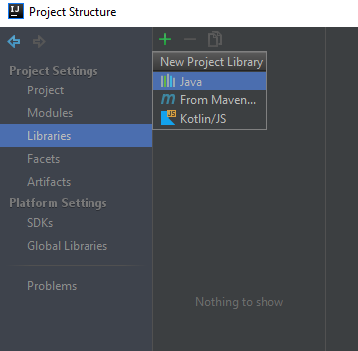
GPDraw
Go to Libraries>+>Java

Slide 30
GPDraw
Go to where you downloaded and saved GPDraw.tar.
Then click OK.
Then click OK again.

Slide 31
Create your first Java class

Slide 32
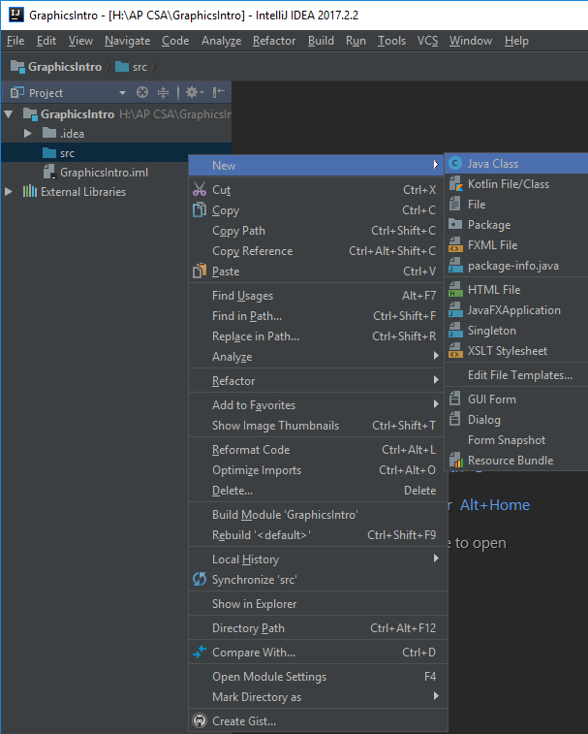
Creating a Class
Right click on src. Click new > Java Class

Slide 33
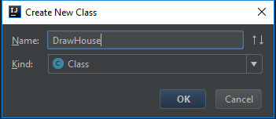
Creating a Class
Call this class DrawHouse

